Slide 1
Data Science and AI on Azure

Slide 2




Artificial Intelligence
Any technique which enables computers to mimic human behavior
Machine Learning
Subset of AI techniques which use statistical methods to enable machines to improve with additional data
Deep Learning
A subset of ML techniques that leverages neural networks with many layers
Bots
A program where user interaction is conversationally focused
Adapted from Figure 1.4 in Ian Goodfellow, Yoshua Bengio & Aaron Courville (2016). Deep Learning. MIT Press

Slide 3

Data Science
Interdisciplinary field of processes and systems to extract insights from data.
It includes data analysis disciplines such as statistics, data mining, and predictive analytics.^{[1]}
[1] Wikipedia entry for ‘Data Science’ – Retrieved July 27, 2018
Adapted from Figure 1.4 in Ian Goodfellow, Yoshua Bengio & Aaron Courville (2016). Deep Learning. MIT Press
Notes:
A data scientist is one who know more stats than a programmer, more programming than a statistician, and has more business domain knowledge then either.

Slide 4









Microsoft AI Platform
Domain Specific Pretrained Models
To reduce time to market
…
Vision
Speech
Language
Search
Familiar Data Science tools
To simplify model development
PyCharm
Jupyter
Visual Studio Code
Command line
Popular Frameworks
To build machine learning and deep learning solutions
ONNX
PyTorch
TensorFlow
Scikit-Learn
Productive Services
To empower data science and development teams
Azure Databricks
Azure Machine Learning
Notebook VMs
Powerful Infrastructure and Data Stores
To accelerate deep learning and data science
CPU
GPU
FPGA
Azure Data Lake Storage
Azure SQL DW
Notes:
On Azure, we have a simple goal when it comes to machine learning. We want to help you quickly and easily develop machine learning solutions.
To achieve this, we have developed a very comprehensive set of offerings.
There are 5 parts of our Machine Learning portfolio:
First, we have sophisticated pre-trained models built by Microsoft Research for products like Bing, Xbox and Office. We offer these same models for you to use in your apps. They can even be fine tuned with your data.
Second, we support the development tools such as PyCharm, Jupyter notebooks, Visual Studio Code and others that are commonly used by data scientists.
Similarly, we support all of the major machine learning frameworks. Our commitment to the open source ONNX project ensures that you’re not locked into any one framework.
We have built highly productive services that these frameworks can run on. All the things that a data scientist needs to do, we deliver through Azure Machine Learning and Azure Databricks.
To accelerate deep learning, we have also innovated on the hardware layer.
And finally we provide flexible deployment options that span cloud, on-premises and the edge.
Let’s look at these components in more detail starting with frameworks.

Slide 5

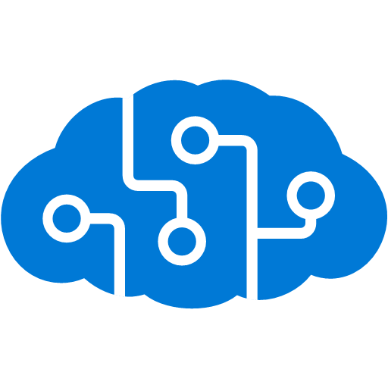

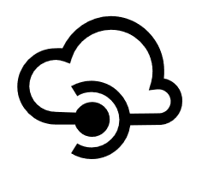

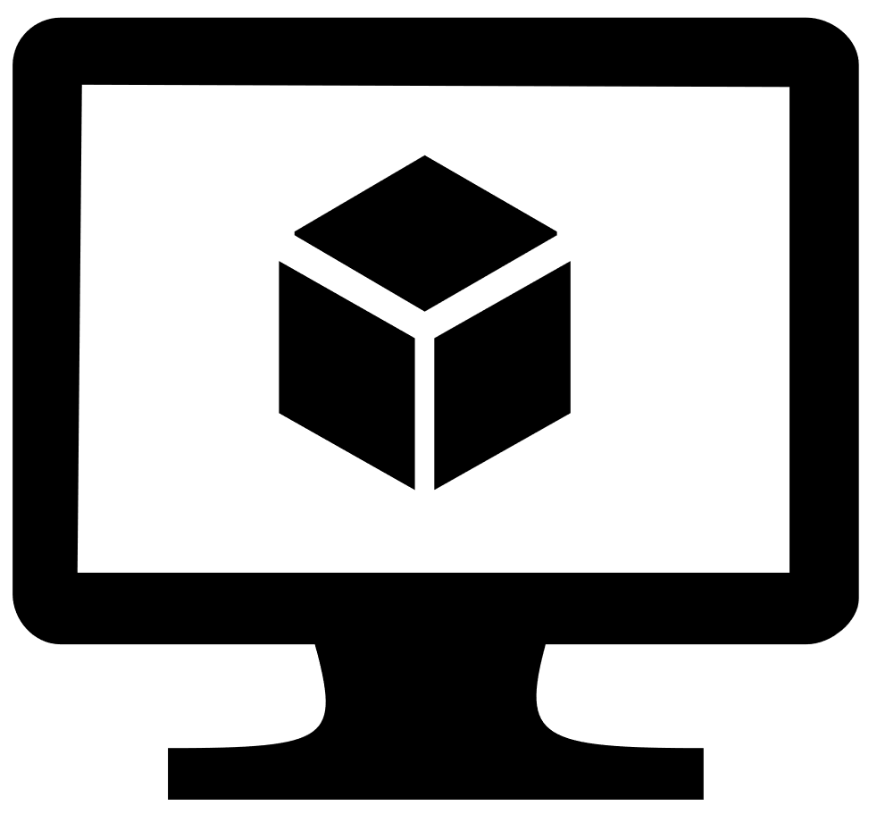

















Azure Data Science and AI Toolkit
PRE-BUILT AI
PREP & TRAIN
MANAGE
DEPLOY
CONSUME
AKS
REST API
Local PC
DSVM
Azure Databricks
Azure Batch AI
Azure Machine Learning
Model Management Service
Azure IoT Edge
Edge Device
Microsoft Cognitive Services
Version Control
Experiment and Asset Tracking
Process
Accelerators
TOOLS
Git
VSTS
Azure Machine Learning
Experimentation Service
Team Data Science Process
Azure ML Packages
STORE
SQL
On Premise Databases
Azure Data Lake Store
Cosmos DB
SQL Database
Azure SQL DW
LANGUAGES AND
FRAMEWORKS
…and others
Microsoft Confidential
Notes:
Alternative slide for Data Science and AI Toolkit
DevOps for Data Science
Standard tools like Git for version control and Docker for deployment
AzureML Packages to enable CI/CD Pipelines
Standardized process and project templates to enable consistency

Slide 6



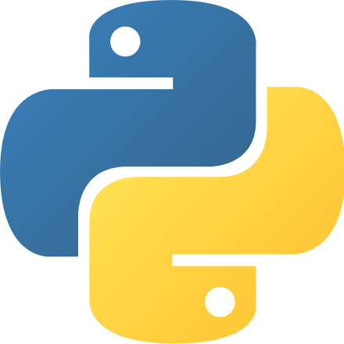
Reference End-to-End Architecture
Ingest
Store
Prep and Train
Serve
Model Serving
Azure Kubernetes service
Streaming data
Operational Databases
Apps
Azure Event Hubs
Cosmos DB, SQL DB
Azure
Databricks
Azure Machine Learning service
Ad-hoc Analysis
Power BI
Batch data
Azure Analysis Services
Azure Data Factory
Azure Data Lake Storage
Azure SQL Data Warehouse
Notes:
Implementing advanced analytics solutions in your organization is a four-step process.
First, you need to ingest data from a variety of data sources, including batch and streaming data.
Azure HDInsight allows you to ingest data at scale in real-time
Azure Data Factory enables you to ingest structured and unstructured batch data at scale, in addition to orchestrating your data preparation processes
Then, you need to take in and store disparate data that’s being ingested regardless of data volumes, variety, and velocity.
With Azure Blob Storage, you can build data integration pipelines that span on-premises and cloud
Next, you need to cleanse, prepare, and train your data.
Azure Databricks enables data scientists and data engineers to collaboratively build and test ML and AI models in the fastest Spark environment
Finally, you need to model and serve this prepared data to your applications, bots, and agents.
Azure Cosmos DB offers low-latency for massively scalable applications
With Azure SQL Data Warehouse, you can easily integrate with leading BI solutions, such as Power BI
<Transition>: Today, we want to focus on preparing and training advanced analytics models.

